Slide 1
Military Expenditure Analysis
(Top 10+ Countries)
Praneeth Tamvada

Slide 2
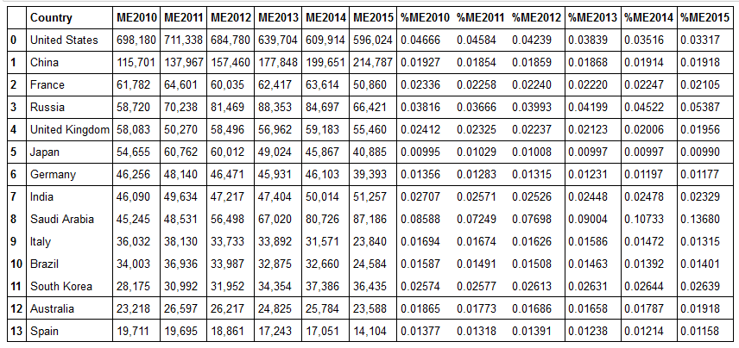
Military Expenditure
Military Expenditure and percentage of Military expenditure to GDP of top 14 countries in current US Millions

Slide 3
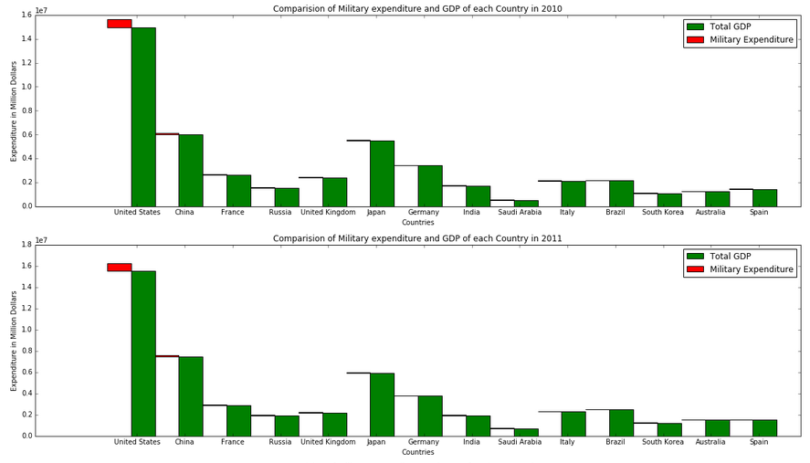
Military Expenditure v/s Country’s GDP for 2010 and 2011

Slide 4
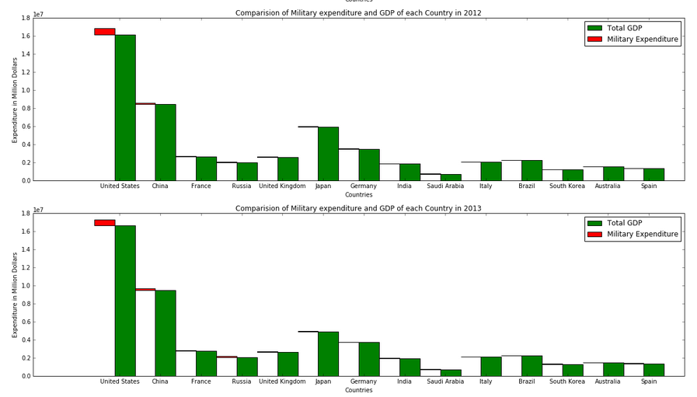
Military Expenditure v/s Country’s GDP for 2012 and 2013

Slide 5
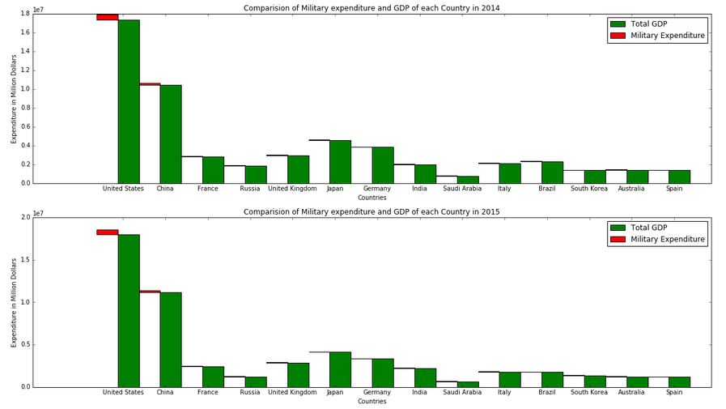
Military Expenditure v/s Country’s GDP for 2014 and 2015

Slide 6
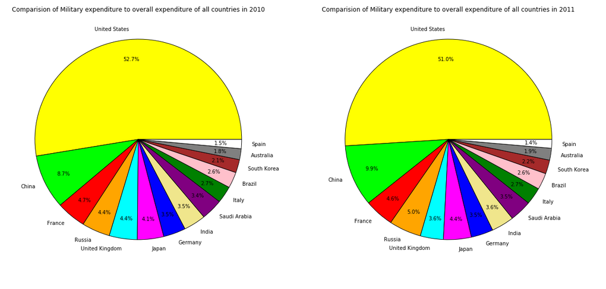
Military Expenditure v/s Overall Military Spending for 2010 and 2011

Slide 7
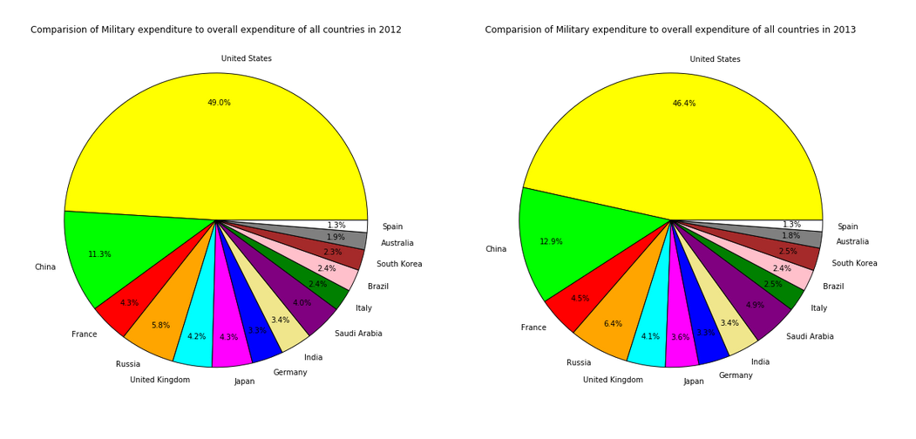
Military Expenditure v/s Overall Military Spending for 2012 and 2013

Slide 8
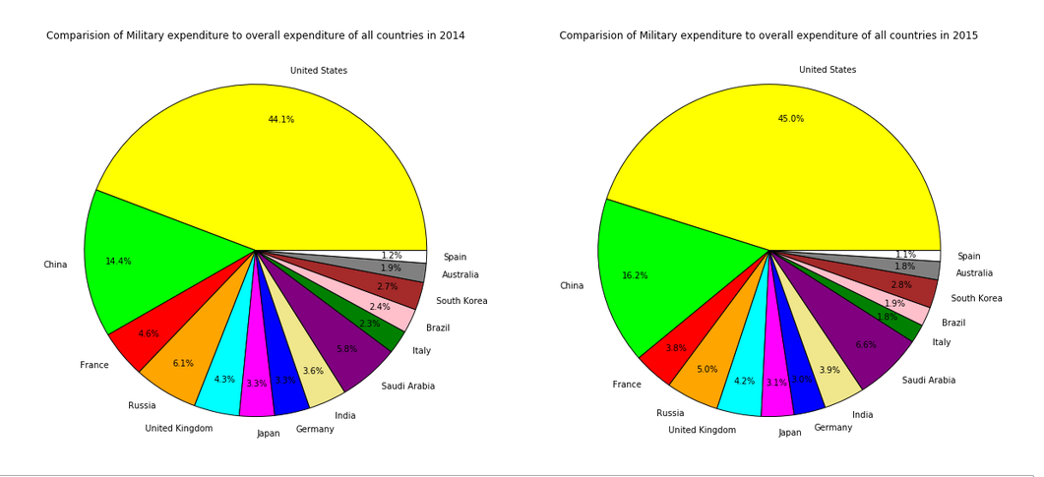
Military Expenditure v/s Overall Military Spending for 2014 and 2015

Slide 9
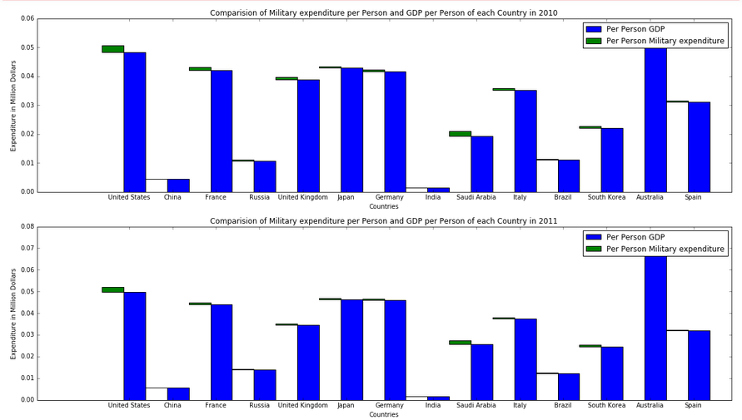
Per Person Military Expenditure v/s Per Person GDP for 2010 and 2011

Slide 10
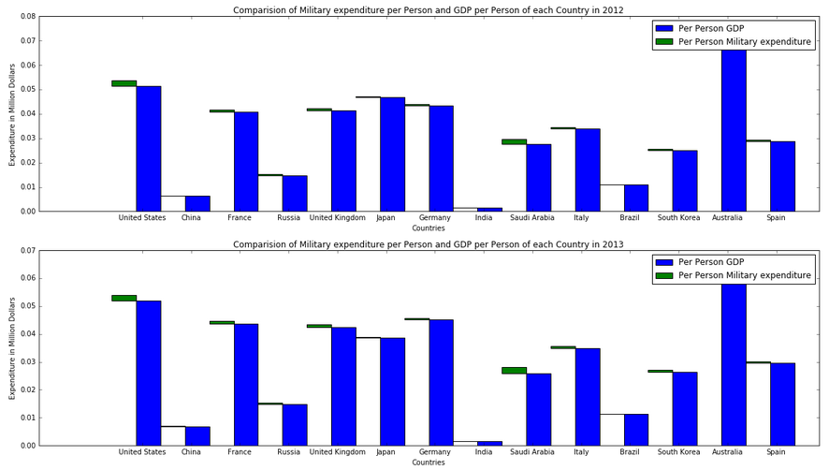
Per Person Military Expenditure v/s Per Person GDP for 2012 and 2013

Slide 11
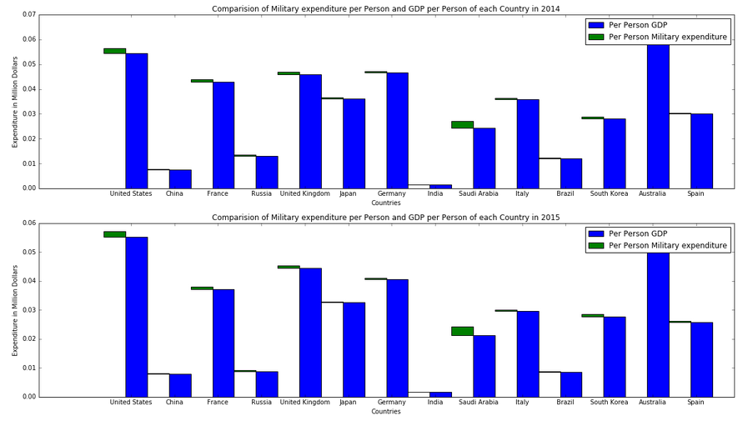
Per Person Military Expenditure v/s Per Person GDP for 2014 and 2015

Slide 12
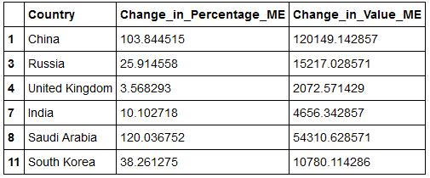
Fastest Growing Countries
Change in Value ME is in millions

Slide 13
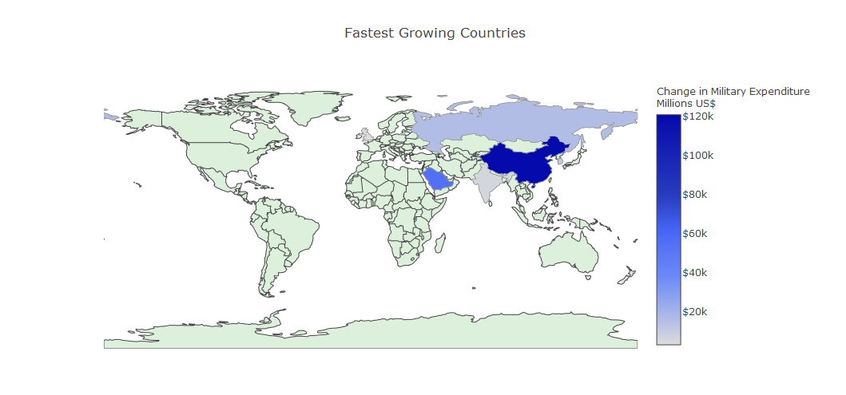
Fastest Growing Countries on Choropleth Map

Slide 14
Thank you

